Slide 1
Emergency Preparedness Boot Camp for Rural Health Clinics
October 29, 2019

Slide 2
What we will cover
This training is designed for health care organizations with existing emergency plans or mandates requiring plans be developed
Participants will discover the Four Phases of Emergency Management focusing on the Preparedness Cycle
Participants will discuss emergency preparedness program management activities to include Incident Command and emergency communications
Participants will complete activities and documents throughout the training that are specific to their organization and can be integrated into existing plans
This training will addresses core planning aspects of the 2016 CMS Preparedness Rule

Slide 3
Planning Strategies
Four Phases of Emergency Management
Preparedness Cycle
What drives/inhibits preparedness?
Planning Strategies
Disaster Myths

Slide 4
Four Phases of Emergency Management
DISASTER
Notes:
Since World War II emergency management has focused primarily on preparedness. Often this involved preparing for enemy attack. Community preparedness for all disasters requires identifying resources and expertise in advance, and planning how these can be used in a disaster. However, preparedness is only one phase of emergency management. Current thinking defines four phases of emergency management: mitigation, preparedness, response, and recovery. There are entire courses on each of these phases.
Mitigation
Preventing future emergencies or minimizing their effects
Includes any activities that prevent an emergency, reduce the chance of an emergency happening, or reduce the damaging effects of unavoidable emergencies.
Buying flood and fire insurance for your home is a mitigation activity.
Mitigation activities take place before and after emergencies.
Preparedness
Preparing to handle an emergency
Includes plans or preparations made to save lives and to help response and rescue operations.
Evacuation plans and stocking food and water are both examples of preparedness.
Preparedness activities take place before an emergency occurs.
Response
Responding safely to an emergency
Includes actions taken to save lives and prevent further property damage in an emergency situation. Response is putting your preparedness plans into action.
Seeking shelter from a tornado or turning off gas valves in an earthquake are both response activities.
Response activities take place during an emergency.
Recovery
Recovering from an emergency
Includes actions taken to return to a normal or an even safer situation following an emergency.
Recovery includes getting financial assistance to help pay for the repairs.
Recovery activities take place after an emergency.

Slide 5
Preparedness Cycle
Notes:
Emergency Preparedness is a continuous cycle of planning, organizing, equipping, training, exercising, evaluating and taking corrective action to enable effective coordination during emergency response operations. By increasing the preparedness of the whole community, we can reduce the impact of future disasters on life, property, and the economy.
The Preparedness Cycle is one element of a broader National Preparedness System to prevent, protect against, respond to, recover from and mitigate against natural disasters, acts of terrorism, and other man-made disasters.
The Preparedness Cycle elements include:
Prevention focuses on creating concrete plans, training, hazard response plans and exercises well ahead of a disaster to prepare your organization, through proactive planning, the risk of loss of life and injury can be limited through good evacuation plans, environmental planning and design standards.
Preparedness is a continuous cycle of planning, organizing, training, equipping, exercising, evaluating, and taking corrective action. These elements are the cornerstones of preparedness and focus on readiness to respond to all-hazards incidents and emergencies.
Response is the management of resources including personnel, equipment, and supplies and utilize the Incident Command System in an all-hazards approach. The response phase is a reaction to the occurrence of a catastrophic disaster.
Recovery activities continue beyond the emergency period and focus on restoring critical functions to stabilize operations and increase capacity to continue to serve their community after a disaster. The goal of the recovery phase is to bring the affected area back to some degree of normalcy as soon as possible.
Mitigation is the effort to reduce loss of life and property by developing structural and non-structural measures that will mitigate the effects of a disaster.
Other Emergency Preparedness Strategies Include:
Emergency Preparedness activities should be completed year round
Emergency Preparedness is a continuous cycle of process improvement
It is important to document gaps in your emergency preparedness capacity so improvements can be made to your systems
It’s important to “calendar” emergency preparedness activities so that are regularly scheduled throughout the year.
Emergency Preparedness activities drive the preparedness cycle

Slide 6
What drives preparedness…
Mandates
Regulations
Hot topics
Past experience
Individual or organizational initiative

Slide 7
What inhibits preparedness…
Time
Money
Lack of knowledge
Lack of interest
Lack of technical expertise

Slide 8
Planning Strategies
Facilitating decision-making
Managing expectations
“You are the help until help arrives” -FEMA

Slide 9
Disaster Myths vs Fact
Myth: Nothing like that could ever happen here or to me.
Fact: Though some areas of the country are more prone to certain types of disasters, the truth is that no area on earth is completely immune from disasters or general disruption.
Jacob, B., Mawson, A., Payton, M., & Guignard, J. (2008). Disaster Mythology and Fact: Hurricane Katrina and Social

Slide 10
Disaster Myths vs Fact
Myth: If something happens all I have to do is call 911 and someone will come help me.
Fact: When a major disaster strikes, help from local emergency personnel can only go so far or be there only so quickly. The best thing people can do to help themselves and to help others is to prepare so they need as little outside help as possible.
Jacob, B., Mawson, A., Payton, M., & Guignard, J. (2008). Disaster Mythology and Fact: Hurricane Katrina and Social

Slide 11
Disaster Myths vs Fact
Myth: Affected population is too shocked and helpless to take responsibility for its own survival.
Fact: Many people find new strength and resiliency during an emergency.
Jacob, B., Mawson, A., Payton, M., & Guignard, J. (2008). Disaster Mythology and Fact: Hurricane Katrina and Social

Slide 12
Disaster Myths vs Fact
Myth: Disasters are random killers.
Fact: Disasters strike the most vulnerable groups hardest.
Jacob, B., Mawson, A., Payton, M., & Guignard, J. (2008). Disaster Mythology and Fact: Hurricane Katrina and Social

Slide 13
Program Management
Emergency Management Committee
Emergency Management Meeting Agenda
ICS and ICS Succession Planning
Discussion-Based Exercises

Slide 14
Emergency Management Committee
Membership
Meetings
Integration in organization
Activity 1: Develop or review/revise committee membership
Notes:
Activity 1: Develop or review/revise committee membership
Look at handout 1. Emergency Management Committee;
Do handout 1a. Emergency Management Committee Membership;

Slide 15
Emergency Management Meeting Agenda
Standard content
Best practices
Activity 2: Develop or review/revise meeting agenda
Notes:
Activity 2: Develop or review/revise meeting agenda

Slide 16
ICS and Succession Planning
The Incident Command System is an organizational structure designed to meet the complexity and demands of emergency response and is integrated with community response partners
Core ICS principles:
  Management by Objectives
  Unity of Command
  Span of Control
  Interoperability
  Flexible and Modular Organization
IS-100.C: Introduction to the Incident Command System, ICS 100
https://training.fema.gov/is/courseoverview.aspx?code=IS-100.c

Slide 17
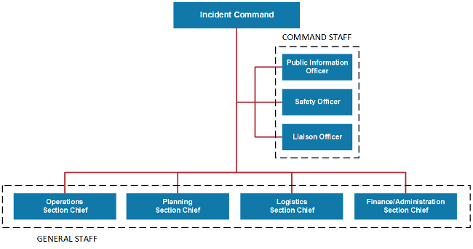
Simplified ICS Chart

Slide 18
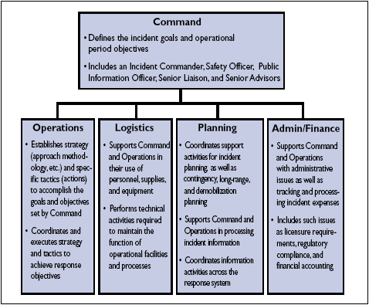
Simplified ICS Chart

Slide 19
Succession Planning
Planning for absence, illness
Multiple shifts
Challenges of succession planning

Slide 20
Emergency Operations Center (EOC)
Central location that serves as a base of operations for facility’s Incident Command System.
A pre-identified and equipped EOC will ensure more rapid and effective response.
May be conference room, break room, or large office.
Consider backup EOC

Slide 21
ICS and Succession Planning
Activity 3: Develop or review/revise ICS structure and identify primary and secondary EOC locations
Activity 4: Identify primary and secondary leadership for succession planning
Notes:
Activity 3: Develop or review/revise ICS structure and identify primary and secondary EOC locations
Activity 4: Identify primary and secondary leadership for succession planning

Slide 22
Discussion-based Exercises
Uses and benefits
Activity 5: Conduct five-minute exercise
Notes:
Activity 5: Conduct five-minute exercise

Slide 23
Communication

Slide 24
Notification and Communication
Importance of notification and communication
Target audiences
Methods of communication
Communication requirements
Activity 6: Emergency notifications worksheet
Notes:
Activity 6: Emergency notifications worksheet

Slide 25
Essential Services

Slide 26
Essential Services
Rationale for defining essential services
Expanding, maintaining, suspending, not providing services
Activity 7: First column of Essential Services and Staffing Plan Worksheet
Notes:
Activity 7: First column of Essential Services and Staffing Plan Worksheet

Slide 27
Discussion Question
A significant rain storm has caused a multiple-day power outage and damage to part of your building. What are the best methods of communication to patients and staff? How can you adjust your services to account for the loss of part of your building?

Slide 28
Staffing

Slide 29
Staffing
Consider how to fulfill essential services with minimal staff.
What services can you offer with 25%, 50%, 75%, 100% staff
availability?
How will you prioritize services to return to normal?
Activity 7: Complete Essential Services and Staffing Plan Worksheet
Notes:
Activity 7: Complete Essential Services and Staffing Plan Worksheet

Slide 30
Discussion Question
A neighboring county has had to evacuate to your community due to flooding. Evacuees are unable to contact their primary physicians, and many have multiple medical needs that the shelter medical teams are unable to meet. What steps do you need to take to accept new patients and how can you ensure continuity of care? How would you adjust services to meet the needs of this population?

Slide 31
Resources

Slide 32
Resource Management
What you have
What you need
Potential source(s) for emergency acquisition
Activity 8: Identify resource availability and resource needs to be able to conduct essential services

Slide 33
Partnerships

Slide 34
Partnerships and Coordination
Effective disaster response is a community response
Disasters begin and end at the local level
Needing help
Giving help
Activity 9: Identify known or potential partners that can help meet resource needs

Slide 35
Discussion Question
There has been a supply chain issue regarding the delivery of medical supplies. PPE materials such as gloves, masks, and hand sanitizer are almost out of stock. How can you make sure that patients are able to still be seen? Are there ways to function without these necessities for a few days?

Slide 36
Alternate Clinical Site

Slide 37
Identify an Alternate Clinic Site
Unlikely to need to move long term into another location
If you're asking the local emergency management agency for assistance finding space, what do you tell them you need?
Activity 10: Identify minimum and ideal space and resource needs for long term operation out of a different facility

Slide 38
What we covered
Participants will discover the Four Phases of Emergency Management focusing on the Preparedness Cycle
Participants will discuss emergency preparedness program management activities to include Incident Command and emergency communications
Participants will complete activities and documents throughout the training that are specific to their organization and can be integrated into existing plans
This training will addresses core planning aspects of the 2016 CMS Preparedness Rule

Slide 39
Resources
Louisiana Governor’s Office of Homeland Security and Emergency Preparedness
https://gohsep.la.gov/
LDH Health Standards
http://ldh.la.gov/index.cfm/page/297
ASPER TRACIE
https://asprtracie.hhs.gov/
FEMA Online Training
https://training.fema.gov/is/
Nicole Peace Coarsey, MPA
nicole.coarsey@la.gov
225-342-1583

